Slide 1
Hosting a Static Website on Amazon S3 with Secure Access

Slide 2

About Me
Vibin Cholayil
I’m a DevOps and Cloud Engineer specialize in delivering fast, efficient solutions across the Agile software development lifecycle.
Excel in building, scaling, and maintaining cloud-native applications using a wide range of DevOps tools.
I focus on system stability, security, and infrastructure management, deploying and maintaining applications, configuring CI/CD pipelines, and managing AWS and Azure services.

Slide 3
About Session
Amazon S3 (Simple Storage Service) serverless, scalable alternative that enables users to host static websites with minimal configuration.
Hosting Static Websites
Scalable and Cost-Effective
Global Content Delivery
Security with Simple Access Control

Slide 4
Problem Statement
Web applications increasingly demand cost-effective, highly available, and globally accessible solutions for hosting static content.
Traditional web hosting approaches involve managing web servers, configuring complex software stacks, and incurring high operational overhead.
S3 has critical security and access management challenges when exposing buckets to the public:
Unrestricted Public Access Risks
Lack of Granular Control
Secure Integration with Other AWS Services
Compliance and Data Protection
Visibility and Debugging Issues

Slide 5
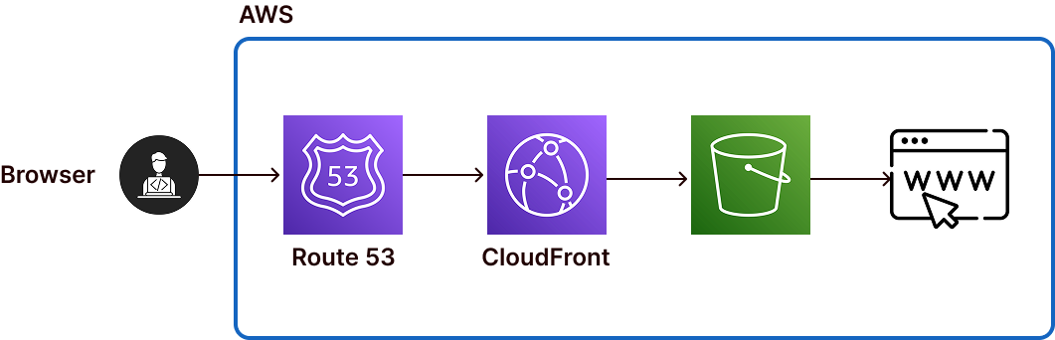
Diagram

Slide 6
Prerequisites
Access to an AWS account.
Familiarity with AWS S3, IAM (Identity and Access Management), and Bucket Policies.
A basic understanding of static website hosting concepts.
AWS Management Console access.

Slide 7
Implementation Steps
Configuring a Secure Bucket Policy
Prepare S3 Bucket
Enable Static Website Hosting
Define a Bucket Policy
Test Website Access

Slide 8

Thank you…
Please Follow me in Linkedin
www.linkedin.com/in/vibincholayil

